Slide 1
Git for beginners
Klas Mellbourn
klas@mellbourn.net
github.com/mellbourn
stackoverflow.com/users/46194
Notes:
Git course - introduce myself

Slide 2
Curriculum
total time about 3h
overview
basics
theory
undoing
ignoring stuff
Visual Studio
branches
remotes
remote branches
Notes:
can be held in 3.5h if in a pinch, skip some walkthoughs then
2.5h is possible, but really too little time.

Slide 3
What is Git?
Distributed Version Control System
each repository independent and has complete version history
communication at well defined points
most commands local
  commit
  branch
  merge
  history
fast
offline is the normal case
each clone is a backup
Notes:
not really a client-server relationship
each repo has a complete version history

Slide 4
Git Clients
Open source
many clients
  git command line
    with powershell module: posh-git
  Git Extensions (stand alone gui client)
  TortoiseGit (stand alone gui client, shell integration)
  SourceTree (cross platform gui client)
  Visual Studio Microsoft Git source control Provider
    built in to all versions
    VS2015 even has method level git history
Notes:
some GUIs tries to hide what makes git special
Microsoft committed to git
also woth mentioning: sourcetree

Slide 5
Absolute basics
create a file
create a repository
set username
commit
show history
change
show history
Notes:
note that no central repo is necessary
note: when in a directory with a .git repo, the git tools detect this
Make several lines in the files
mkdir c:\course
mkdir project
add a text file foo.txt
add lines 1,2,3,4,5
create new repo
bring up git extensions
set up username
commit
make change
commit

Slide 6
Local
Note that we have no server (yet)
You can always quickly create a git repository
Notes:
Personally I often create version controlled folders at home, without any remote
Easy and fast to creat repos. Notice how many on Bitbucket already

Slide 7
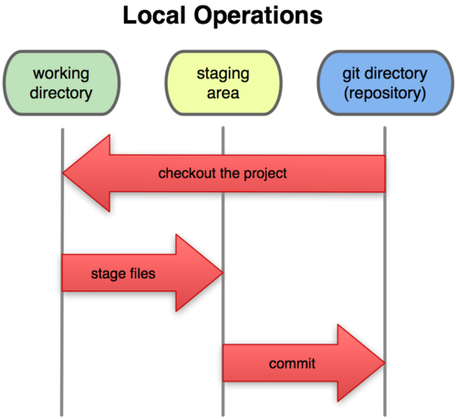
Staging

Slide 8
more changes
add files
stage one, commit it
stage another, commit it
change file
partially stage
commit
view history
note that you can see the file tree in each commit
Notes:
add modifications “feature 1”, “feature 2”

Slide 9
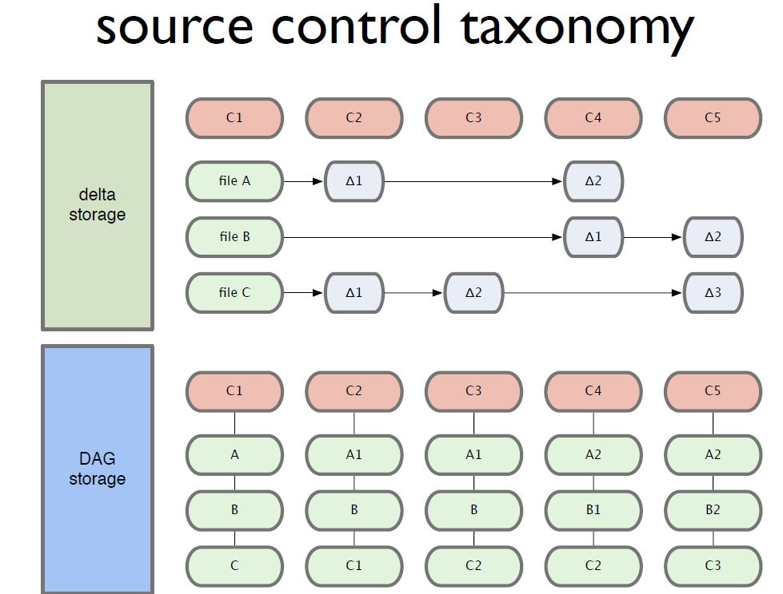
Delta storage vs Directed Acyclic Graph
Not deltas,
Snapshots!
Notes:
show 43-58

Slide 10
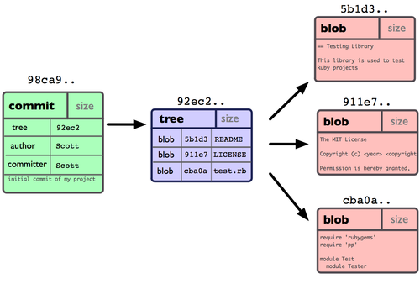
Content addressable
Notes:
each blob and tree has a content hash as it’s name.
the tree points to the blob using the hash!
used internally by git to figure out if a commit needs to be fetched from a remote or not
Note that it is very hard in a truly distributed system to have sequential version numbers

Slide 11
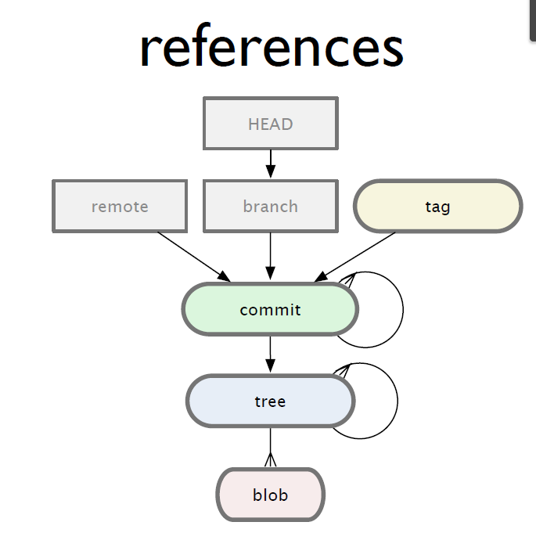
references
Notes:
show 136-152, show trees in git extensions browser, show the parent pointer
+7min=30min

Slide 12
Undoing things
resetting working directory
reverting commits
reset - move branch to a commit
  hard
  soft
amending commits
Notes:
reset using commit dialog
mention: revert a merge
jump back and forth using reset
you said that you cannot loose committed stuff in git
+6min

Slide 13
amend
Amend A:
Problem,
someone else:
master
master
A’
master
A
A’
A
A

Slide 14
.gitignore
Some files you don’t want to version control
Put them in .gitignore
Demo: Visual Studio
note that the tree of the commit does not contain all files
Notes:
First show ignoring in simple solution. foo.dll
start by using Visual Studio here
ConsoleApp_alice
ignore *.orig
(remove text auto attribute)
git config --local --unset merge.tool (since no three way merge)
(git config mergetool.prompt false)
set name
git config --local user.name “Alice”
git ocnfig --local user.email alice@hm.com
show change

Slide 15
Branching
In git you branch a lot!
branch
checkout (switch branch)
merge
  reintegration merge
  conflict resolution
Notes:
feature: math and add output
master: rename Program and add output
Note: in git you do not create a new folder for a new branch
fishbone pattern
+26min. This is how far I actually got in two hours 2014-06-03

Slide 16
Remotes
git clone
remotes
remote branches vs local branches
push
pull
Notes:
point out that you need only files: no registry, no database, no server processes
create two repositories Alice and Bob
do pushes and pulls
clone Alice to a central repo or push -u
do all using Git Extensions!
(git remote add orgin ..\ConsoleApp.git
git fetch
git branch -u origin/master)
git clone ConsoleApp.git bob_ConsoleApp
git config user.name Bob
git config user.email bob@hm.com)

Slide 17
Clone
central repo - “origin”remote
master
A
B
Clone
Push
Alice
Bob
master
A
B
master
origin/master
A
B
origin/master

Slide 18
push/pull - the simple case
central repo - “origin”remote
master
A
B
C
Pull
Push
Alice
Bob
master
A
B
C
master
origin/master
A
B
C
origin/master

Slide 19
Push/pull with merging
central repo - “origin”remote
master
A
B
C
Pull
Push
Alice
Bob
master
A
B
C
master
origin/master
A
B
D
M
C
origin/master
Notes:
show rejection
pull = fetch + merge
example changes:
Math class
renaming stuf

Slide 20
feature branch workflow
create a feature branch
checkout feature branch
make commits until done with feature
checkout master
pull master
merge feature into master
make sure everything works
push master
Notes:
feature branch example
you should not normally do development on master, branch!
isolated environment, clearer history

Slide 21
update your feature branch
Merge from master to integrate latest changes
fishbone pattern:
master
feature
Notes:
git handles reintegration merges well,
takes advantage of earlier conflict resolution

Slide 22
remote branches
You can push and pull other branches than master
This way you can share work on a feature branch
Branches that are local on the remote are reproduced as “remote branches” in your repository
Remote branches cannot themselves be checked out
Local branches can track remote branches
Notes:
remote branches are in the local repository,
create feature branch that they should collaborate on (multiplication/division)
explain colours in git extensions
let alice make a bug correction in master and push it
mention teamcity build possibility
+15min

Slide 23
Tags
label a version with a tag
pointer to a commit
if annotated it also has
  comment, tagger, date
  hash
does not move (like branches do)
cannot be checked out (like branches)
must be pushed specifically
Notes:
wait, you have been nagging us about how a branch is a pointer to a commit, WTF?
reference tag vs annotated tag

Slide 24
stash
Save changes “temporarily”
clears any changes from working tree and staging area
can be applied later
  even on different commit
can popped or applied or dropped
Notes:
show first one stash, pop it,
save it again using a name
save another stash
demonstrate the stash list

Slide 25
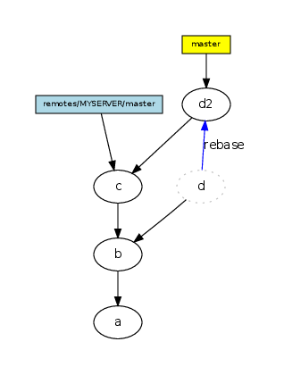
Rebase
A rebase replays the
differences introduced by
commits, creating new
“copied” commits.
cleaner history
fewer commits
don’t do it with pushed
commits
Notes:
sign Git to Manage...” slide 218-227
fewer
show how to make a feature branch with no commits
pull with rebase
use same branch as before, just delete the remote
I just barely finished this in another 2h (total 4h with two 10min breaks), skipping briefly over tags and stash
another 30min was good for more about tags, stash and more rebase

Slide 26
Links
gitref.org - quick walkthrough
git-scm.com/book - compete book, especially Chapter 2 (and preferably also chapter 3)
youtube.com/watch?v=ZDR433b0HJY - excellent video on basics (but very command line oriented)
youtube.com/watch?v=ig5E8CcdM9g - advanced video
How to use Git on GitHub
Notes:
some of the graphs in this presentation are from these links
2h52min with ten minute break
More goodies:
Bitbucket/github
fork/pull request
Dynamic branches on TeamCity
3h45min inclusive of goodies

